Slide 1

Cyclistic Rider behavior by membership type
Presented by: David Wishart
Last updated: 19 Jul 26

Slide 2
How do annual members and casual riders use Cyclistic bikes differently?
5.9 million trips made in the last 12 months
Notes:
Over the past 12 months, Cyclistic riders made roughly 5.9 million trips using our bikes. About two-thirds of trips were made by annual members, with the rest made by casual riders.

Slide 3
Casual summer surge
Notes:
The warm months are our busiest months for all riders, with almost 70% of all trips occurring in Q2 and Q3. However this change is particularly marked for casual riders. In Q3 the split of casual rider trips to annual member trips is 41/59, but in Q1 it is 23/77. This suggests that there is a surge in casual riding starting in spring and lasting through to fall.

Slide 4
Classic or Electric?
Notes:
Electric bikes are more popular among all rider types. On whole about two-thirds of trips were made using our electric bikes. This preference is slightly more pronounced among casual riders, as just over 70% of trips were made with electric bikes.

Slide 5
Casual weekend surge
Notes:
The distribution of casual vs member trips over the week shows a marked contrast between the groups. During the week, members accounted for almost 77% of trips made, whereas at at the weekend this was only 53%. So there is a big surge each weekend in casual riders.

Slide 6
Short commutes and long leisure rides
Notes:
One of the most dramatic contrasts is in the duration of the rides. Here, we can see that members account for about 70% of rides under 10 minutes, whereas casual riders account for over 77% of rides lasting over 90 minutes. This trend shows itself already from rides lasting over 30 minutes, from which point a majority of trips were made by casual riders.

Slide 7
Weekly ride volume by hour
Notes:
When we look at trip start time grouped by hour over the week, we see that there are member surges at weekday commuter times (7am-8am and 4pm-5pm). This pattern vanishes over the weekend.

Slide 8
Average Ride Duration by start time
Notes:
Members on average use bikes for short 10-13 minutes trips across the whole week. At the weekend there seems to be a peak in casual riders using bikes for longer, leisure trips.

Slide 9
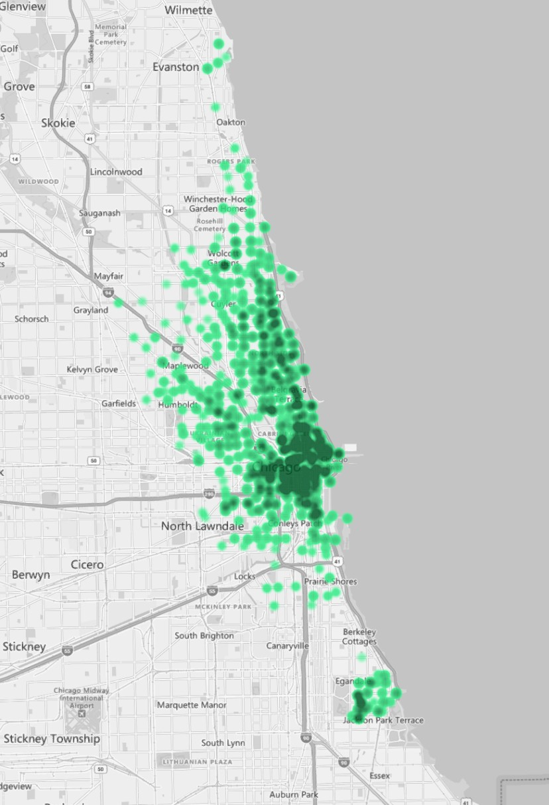
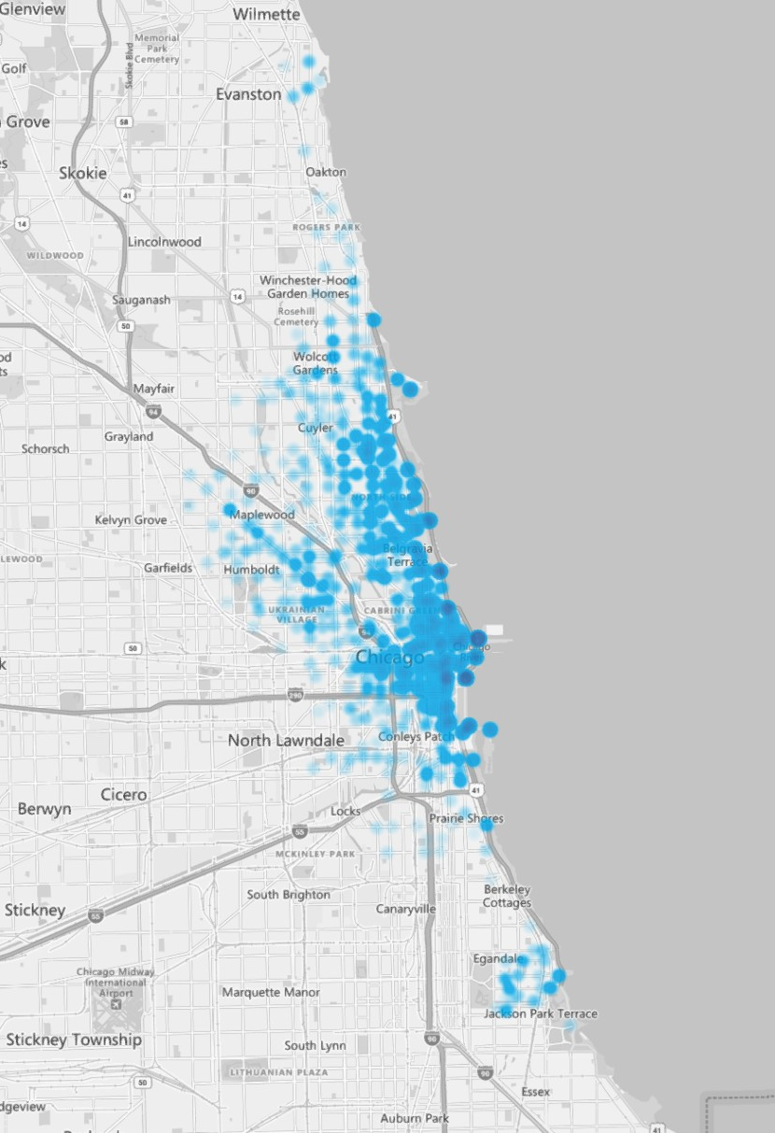
Geographical clustering of top 500 stations
Weekday annual member trips
Weekend casual rider trips
Notes:
Exploratory analysis shows that the most popular casual rider weekend start points are clustered along the waterfront with its recreational areas, whereas the weekday member trips focus around downtown.

Slide 10
Analysis Conclusions
Casual riders especially use the service during the summer months.
Annual members tend to use the service more during the week, casual rider trips then surge at the weekend.
Casual riders account for most of the long (30+ minute) trips, annual members take shorter rides.
There are clear ‘commuter spikes’ during midweek rush hours for annual members. Casual rider trips follow a softer ‘afternoon and weekend leisure’ curve.
Annual members tend to start downtown in commercial areas, casual riders nearer the waterfront park and recreation areas.

Slide 11
Recommendations to convert casual riders to annual members
Target marketing during spring as casual riders begin using the service more.
Design targeted, limited-time promotions that frame the annual membership as a cost-saving tool for high-frequency weekend and seasonal leisure users.
Target marketing around recreational areas of the city.

